Slide 1

Introduction to SketchEngine
and Web as Corpus research
In this video you will be introduced to
SketchEngine web tool for corpus linguistics
WebBootCat tool in SkE to collect a corpus from the Web
how to use SkE to collect and analyse text data from the Web
Leeds Internet Corpora with seed-words for a large corpus
ACL SIGWAC: Association for Computational Linguistics Special Interest Group on Web as Corpus.
Texts you should read for part 1.3:
A Kilgarriff et al. 2014. The SketchEngine ten years on.
Websites – see Minerva learning resources

Slide 2
SketchEngine
Word sketch – summary of a word's collocational behaviour
Concordance – examples of a word, lemma, phrase in context
Distributional Thesaurus –words with similar meaning / context
Parallel corpus – bilingual corpus, for translation examples
WebBootCat – create specialized corpus from web-pages
Terminology – key words and multi-word terms in a specialism
And more …

Slide 3
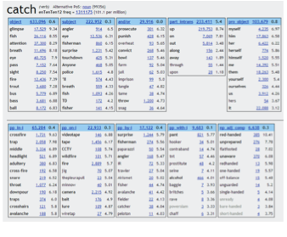
Word sketch – summary of a word's collocational behaviour

Slide 4
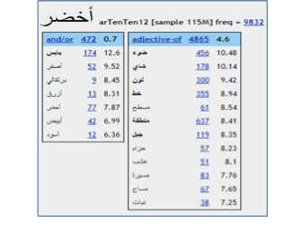
Word sketch – summary of a word's collocational behaviour (Arabic)

Slide 5
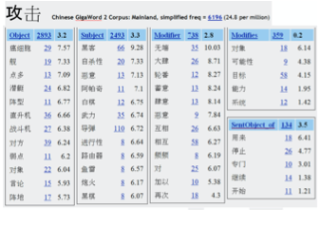
Word sketch – summary of a word's collocational behaviour (Chinese)

Slide 6
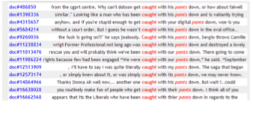
Concordance – examples of a word, lemma, phrase in context

Slide 7
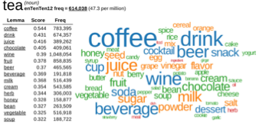
Distributional Thesaurus –words with similar meaning / context

Slide 8
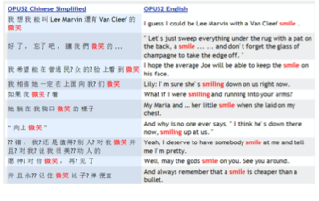
Parallel corpus – bilingual corpus, for translation examples

Slide 9
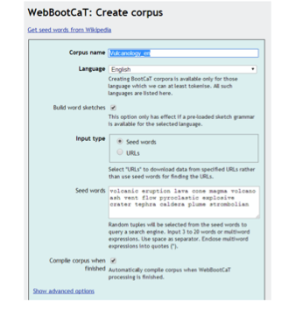
WebBootCat – create corpus from web-pages

Slide 10
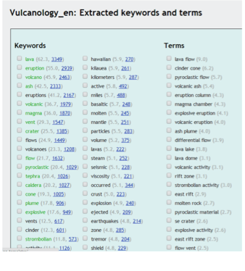
Terminology – key words and multi-word terms in a specialism

Slide 11
More SketchEngine functions
Word lists – frequency lists filtered with user criteria
n-grams – frequency lists of multi-word expressions
Collocations – word co-occurrence analysis
Word sketch difference – compares two words by collocations
Diachronic analysis (Trends) – word usage change over time
Part-of-Speech tagging and lemmatization, in many languages

Slide 12
Web as Corpus research
Use SkE to collect and analyse text data from the Web
Leeds Internet Corpora with seed-words for a large corpus
ACL SIGWAC: Association for Computational Linguistics Special Interest Group on Web as Corpus.

Slide 13
Let’s try them …
SketchEngine www.sketchengine.eu
Leeds Internet Corpora corpus.leeds.ac.uk/internet.html
ACL SIGWAC www.sigwac.org.uk
SketchEngine licence is for on-campus use, or via VPN
it.leeds.ac.uk How to connect to the University VPN:
it.leeds.ac.uk/it?id=kb_article&sysparm_article=KB0014410

Slide 14
Summary
In this video you were introduced to
SketchEngine web tool for corpus linguistics
WebBootCat tool in SkE to collect a corpus from the Web
Leeds Internet Corpora with seed-words for a large corpus
ACL SIGWAC: Association for Computational Linguistics Special Interest Group on Web as Corpus.
Texts you should read for part 1.3:
A Kilgarriff et al. 2014. The SketchEngine ten years on.
Websites – see Minerva learning resources

